Slide 1



TECH COMPANY
PRESENTATION

Slide 2

TECH COMPANY
A presentation is a formal or informal communication method that involves conveying information, ideas, or a message to an audience.
RIMBERIO COMPANY

Slide 3

ABOUT US
A presentation is a formal or informal communication method that involves conveying information, ideas, or a message to an audience. It often employs visual aids such as slides, charts, graphs, or multimedia elements to support and enhance the spoken content.
RIMBERIO COMPANY

Slide 4

VISION
A presentation is a formal or informal communication method that involves conveying information, ideas, or a message to an audience. It often employs visual aids such as slides, charts, graphs, or multimedia elements to support and enhance the spoken content.
RIMBERIO COMPANY

Slide 5

MISSION
A presentation is a formal or informal communication method that involves conveying information, ideas, or a message to an audience. It often employs visual aids such as slides, charts, graphs, or multimedia elements to support and enhance the spoken content.
RIMBERIO COMPANY

Slide 6




TEAM
Juliana Silva
Sascha Dubois
Olivia Wilson
Founder
Designer
Developer

Slide 7

MARKET OVERVIEW
19.5%
$3.7 Billion
29%
Market Growth Rate
Market Size
Growth for 2026
RIMBERIO COMPANY

Slide 8
ROADMAP
Q1
Q2
Q3
Idea Generation
Market Research
Concept
Brand Survey
Brand Awareness & Marketing
Component Research
Cost Analysis
Testing functions
Apps interaction
Product Handling
Launch

Slide 9
Product 2
We build software that empowers organizations to effectively integrate their data, decisions, and operations.
Product 1
Product 3
PRODUCT
Product 4

Slide 10

WHAT WE DO
A presentation is a formal or informal communication method that involves conveying information, ideas, or a message to an audience. It often employs visual aids such as slides, charts, graphs, or multimedia elements to support and enhance the spoken content.
RIMBERIO COMPANY

Slide 11

PROJECT 1
We build software that empowers organizations to effectively integrate their data, decisions, and operations.
We build software that empowers organizations to effectively integrate their data, decisions, and operations.
We build software that empowers organizations to effectively integrate their data, decisions, and operations.

Slide 12
PROJECT 2
We build software that empowers organizations to effectively integrate their data, decisions, and operations.
We build software that empowers organizations to effectively integrate their data, decisions, and operations.
We build software that empowers organizations to effectively integrate their data, decisions, and operations.

Slide 13
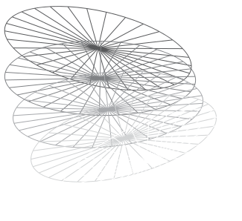
We build software that empowers organizations to effectively integrate their data, decisions, and operations.
RIMBERIO COMPANY

Slide 14

CONTACT US
@reallygreatsite
hello@reallygreatsite.com
www.reallygreatsite.com
123 Anywhere ST., Any City, ST 12345

Slide 15
THANK YOU
TECH COMPANY

